Slide 1
Ditch SQL, use C# to store C# objects in VelocityDB & VelocityGraph NoSQL databases
Tired of mapping layers from .NET to SQL, Json or XML? There is another way to do it!
Mats Persson
@VelocityDB
Notes:
My name is Mats. I have been building NoSQL database engines for the past 18 years.
The first 14 years I build an object database engine called Objectivity/DB. This was using C++.
Today I will show how to build a database with only C# code.
I started building VelocityDB a few years ago. The hardest part is keeping it simple to use. Using C# instead of C++ helps, it is making it easier to use.
With an object database you can still choose to design your data classes with total freedom. This is great but it also makes each application unique, each with a different design.
Graph databases reduces the freedom of choice and makes you design your database with a fixed small set of options. This should make it simpler to use and as a builder of a graph database engine we can focus on optimizing these few data structures.

Slide 2
Introduction to VelocityGraph
Notes:
A couple of years ago I got a request to do a graph database as an extension to VelocityDB.
I got input from other graph databases such as DEX – now called sparcsee but mainly it was driven by input from VelocityDB user’s around the world.
Most of the input came from Vidar at WebNodes in Norway but I also got input from a user in India and another one in Austrailia.
Louis-Pierre in Canada is also an important collaborator.

Slide 3
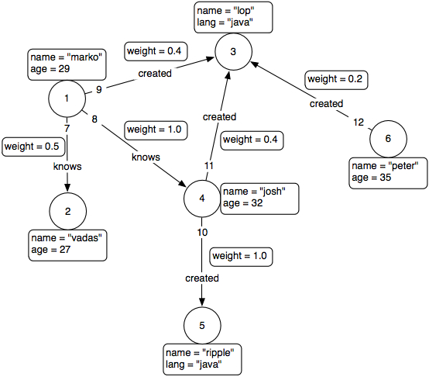
Property Graph Database basic structure
Graph | An object that contains vertices and edges
Vertex | An object that has incoming and outgoing edges
Edge | An object that has a tail and head vertex
Property | A key/value associated with a Vertex or Edge
Edges and Vertices also have an associated id
Notes:
Let’s start by talking about the basic structure of a property graph database. It is really simple: graph, vertex, edge and properties.
Vertex is called node is some other graph databases such as Neo4J.
Edge is a relation or connection between vertices.
Both edges and vertices can have one or more key value properties.
The key of property is always a string.
Each edge and Vertex have an associated id.

Slide 4
Vertex
id
669
Property name (key) | Property Value
“rating” | 4
“Established” | Nov 14, 2015
... | …
Notes:
An object that has incoming and outgoing edges.
A vertex has an id and can have multiple properties.

Slide 5
Edge
tail
id
head
454
out
in
Property name (key) | Property Value
rating | 4
“Established” | Nov 14, 2015
... | …
Can also be bidirectional
Notes:
An object that has a tail and head vertex.
At the tail end, the outgoing side, of an edge we have the tail vertex.
At the head end, the incoming side, of an edge we have the head vertex.
An edge can be either one directional or biderectional.

Slide 6
Property Graph Standard Interfaces
TinkerPop/Blueprints is a standardized interface for Java
Frontenac.Blueprints is a C# port of the Java interfaces
VelocityGraph implements the Frontenac.Blueprints interfaces
Notes:
For Java property graph databases we have an interface standard called TinkerPop/Blueprints.
A couple of years ago, Louis-Pierre in Canada ported the Java interfaces to C#, he named it Frontenac.Blueprints.
Obviously, we made VelocityGraph implement the Frontenac.Blueprints interfaces.

Slide 7
Are graph databases schema less?
No, no database application is schema less.
Database Schema is either:
explicit (relational databases)
implicit (most of NoSQL)
Notes:
Neo4J claims it is schema less but …

Slide 8
VelocityGraph additional structure
VertexType | Useful to distinguish different types of vertices, e.g. user vertices and product vertices.
EdgeType | Useful to distinguish different types of edges, e.g. friends edges and enemies edges.
PropertyType | Useful to distinguish different types of properties, e.g. age property and birthday properties
Polymorphism | VertexType and EdgeType can have a base type. Api like EdgeType.GetEdges(bool polymorphic = false) enables sub types in return value.
Any C# type object as property value. | A Neo4J property value can only be a string, a byte or a number while VelocityGraph supports most C# types as property value.
Notes:
We need more structure, a light weight schema, so that a complex graph can be done efficiently and is readable.
VelocityGraph is an extension to the object database VelocityDB.
Each VelocityDB application has a unique schema but a typical VelocityGraph application has a fixed schema as far as VelocityDB is concerned.
However, we add some structure to VelocityGraph by introducing Vertex, Edge and property types.
As requested we also added polymorphism to vertex and edge types.
Since VelocityGraph is build on VelocityDB, we can easily support property values of any C# type.

Slide 9
VertexType
Also found in OrientDB and sparksee
VertexType userType = graph.NewVertexType("User");
PropertyType genderType = userType.NewProperty("Gender", DataType.Integer, PropertyKind.Indexed);
Vertex aUser = userType.NewVertex();
aUser.SetProperty(genderType, (int)Gender.Male);
Without VertexType (as in BluePrints standard interfaces)
Vertex aVertex = graph.AddVertex();
aVertex.SetProperty("Gender", (int) Gender.Male);
Notes:
VetexType
We want a C# type associated with a particular type of Vertex. In this case a User Vertex.
We create the new VertexType by specifying the name “User”, the value type as being integer and we want values to be indexed for quick lookup by value.
The equivalent to a VertexType is found in other databases supporting graph api, for instance OrientDB and Sparksee

Slide 10
EdgeType
Also found in OrientDB and sparksee
EdgeType ratingEdgeType= graph.NewEdgeType("UserToRating", true, userType, ratingType);
Using API on class Graph
public EdgeType NewEdgeType(string name, bool biderectional, VertexType tailType,
VertexType headType, EdgeType baseType = null)
Notes:
Similarly for EdgeType, we want to create specific a specific type for edges of a certain kind. In this case we have an EdgeType for edges from a user Vertex to a rating Vertex.
We can specify that these type of edges are bidirectional and that the head VertexType is userType and tail VertexType is ratingType.

Slide 11
PropertyType
PropertyType genderType = userType.NewProperty("Gender", DataType.Integer, PropertyKind.Indexed);
Using API on class VertexType and EdgeType
public PropertyType NewProperty(string name, DataType dt, PropertyKind kind)
Notes:
Same idea with PropertyType, we want an object representing a certain type of property. In this case a property “Gender” on the VertexType userType.
When we create the property object, we specify what type of values this type of property will have.
Values can be indexed or not.

Slide 12
Polymorphism
Also found in OrientDB
VertexType userType = graph.NewVertexType("User");
VertexType powerUserType = g.NewVertexType("PowerUser", userType);
Using polymorphic API on class Graph
public VertexType NewVertexType(string name, VertexType baseType = null)
public EdgeType NewEdgeType(string name, bool biderectional, EdgeType baseType = null)
on class EdgeType
public IEnumerable<Edge> GetEdges(bool polymorphic = false)
on class VertexType
public Vertex GetVertex(VertexId vertexId, bool polymorphic = false, bool errorIfNotFound = true)
public IEnumerable<Vertex> GetVertices(bool polymorphic = false)
on class PropertyType
abstract public Vertex GetPropertyVertex(IComparable value, bool polymorphic = false, bool errorIfNotFound = true);
Notes:
We may want to have VertexType “User” and another VertexType based on “User” called “PowerUser”.
We can do that by specifying userType as the base type when we create the “PowerUser” VertexType.
We can take advantage of this polymorphism is api such as getting all the edges of an EdgeType. If we specify true for the parameter, we also can all edges that are based on this edge type.

Slide 13
Any C# type object as property value
VelocityGraph is build as an extension of object database VelocityDB. You can use graphs as a component of your overall application design and you can use any C# type objects as property values.
PropertyType objectPropertyTypeIndexed = graph.NewVertexProperty(movieType, "director", DataType.IOptimizedPersistable,
PropertyKind.Indexed);
Vertex mVickyCB = movieType.NewVertex();
mVickyCB.SetProperty(movieTitleType, "Vicky Cristina Barcelona");
Person pObj = new Person();
mVickyCB.SetProperty(objectPropertyTypeIndexed, pObj);
Vertex lookup = objectPropertyTypeIndexed.GetPropertyVertex(pObj);

Slide 14
Downloading VelocityGraph
Direct link: www.VelocityDB.com/VelocityDbNoServer.exe (14 MB)
Generate 10 day trial license: www.VelocityDB.com/Secure/License.aspx
Then download (click Download button) it to c:/4.odb
Samples pick up license file from c:/4.odb
After 10 days, generate another trial license or pay $200 for a permanent license.
VelocityGraph and all VelocityDB & VelocityGraph sample projects are all open source on GitHub.
VelocityDB and VelocityGraph are available as NuGet.
Notes:
Show how to download and license management.

Slide 15
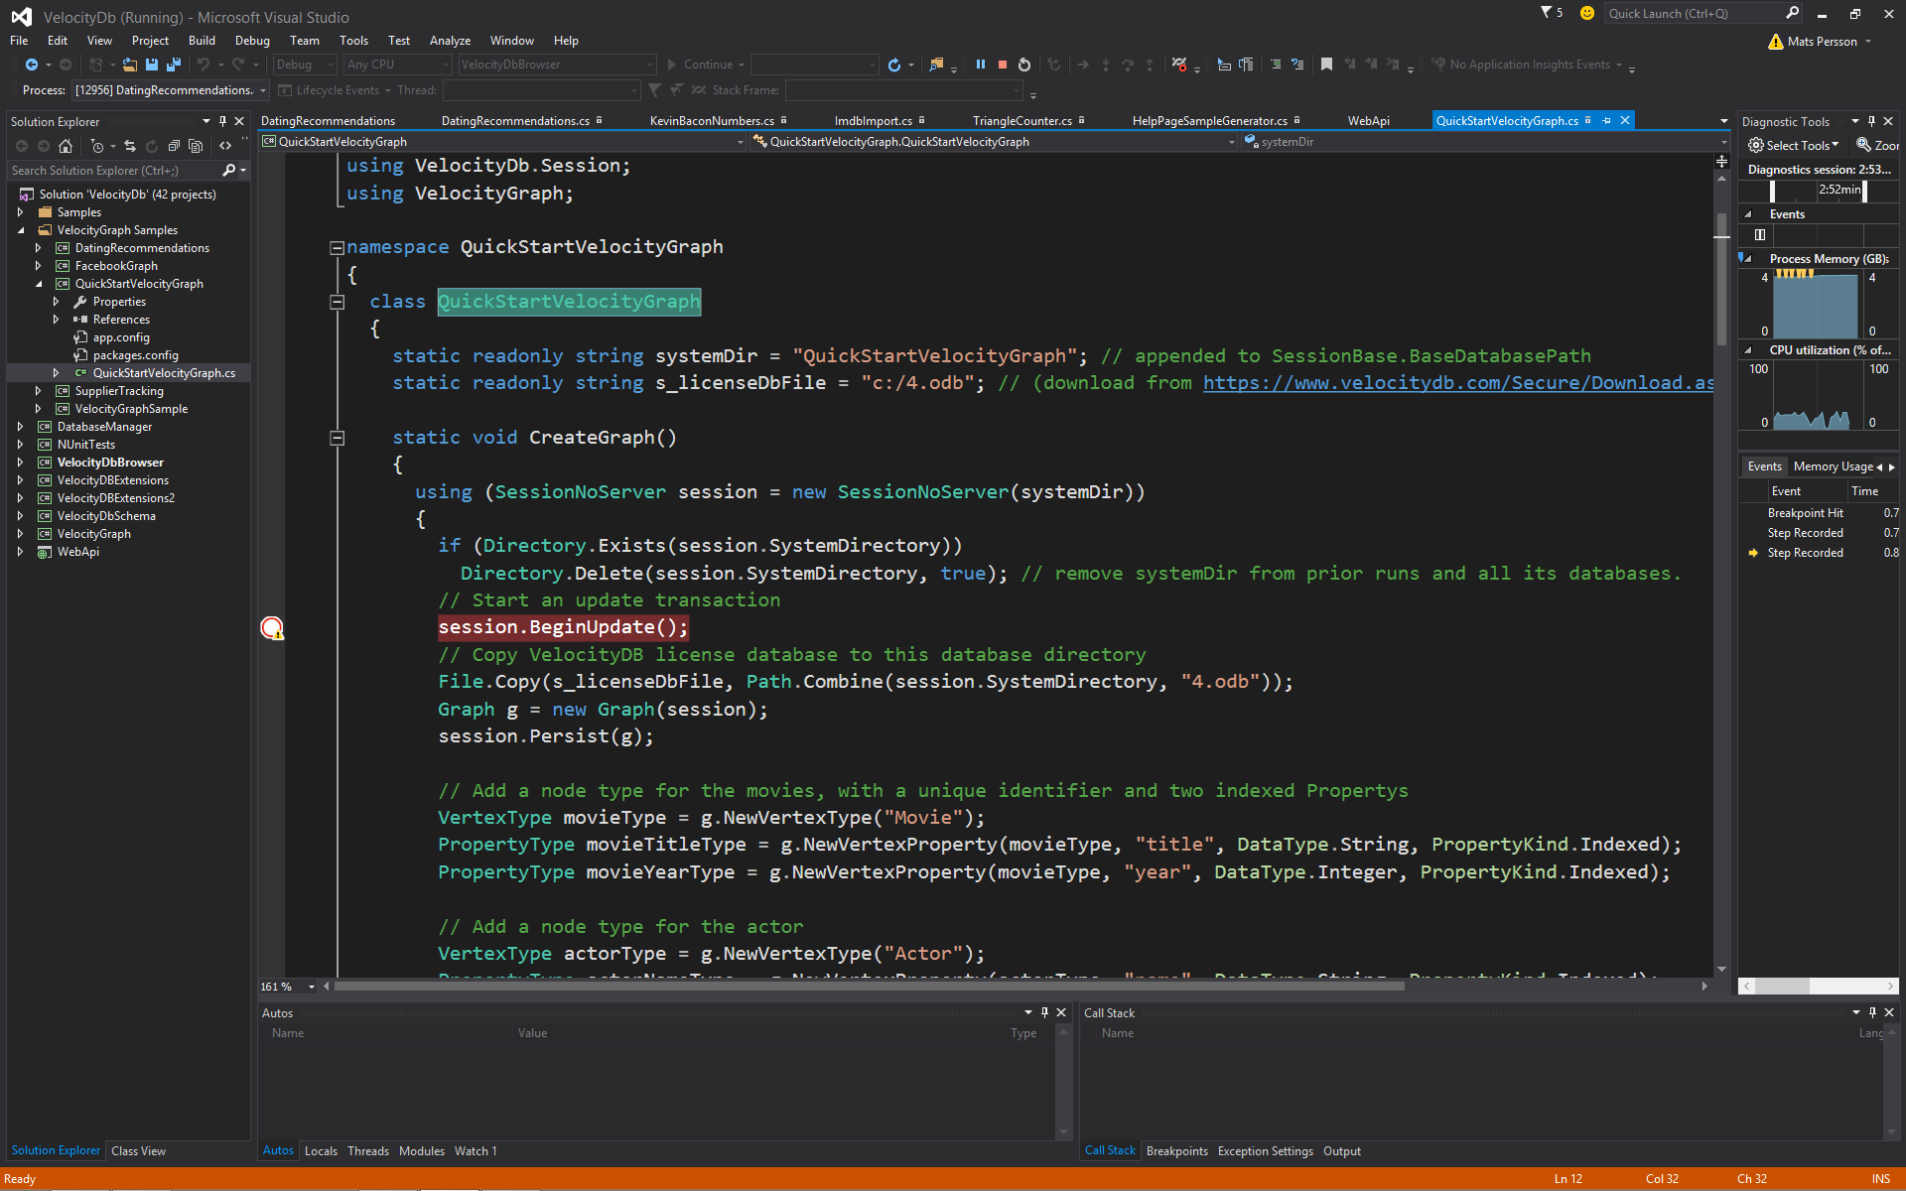
Quick Start sample application
using Frontenac.Blueprints.Util.IO.GraphJson;
using System;
using System.Collections.Generic;
using System.IO;
using System.Linq;
using System.Text;
using VelocityDb.Session;
using VelocityGraph;
namespace QuickStartVelocityGraph
{
class QuickStartVelocityGraph
{
static readonly string systemDir = "QuickStartVelocityGraph"; // appended to SessionBase.BaseDatabasePath
static readonly string s_licenseDbFile = "c:/4.odb"; // (download from https://www.velocitydb.com/Secure/Download.aspx)
static void CreateGraph()
{
using (SessionNoServer session = new SessionNoServer(systemDir))
{
if (Directory.Exists(session.SystemDirectory))
Directory.Delete(session.SystemDirectory, true); // remove systemDir from prior runs and all its databases.
// Start an update transaction
session.BeginUpdate();
// Copy VelocityDB license database to this database directory
File.Copy(s_licenseDbFile, Path.Combine(session.SystemDirectory, "4.odb"));
Graph g = new Graph(session);
session.Persist(g);
// Add a node type for the movies, with a unique identifier and two indexed Propertys
VertexType movieType = g.NewVertexType("Movie");
PropertyType movieTitleType = g.NewVertexProperty(movieType, "title", DataType.String, PropertyKind.Indexed);
PropertyType movieYearType = g.NewVertexProperty(movieType, "year", DataType.Integer, PropertyKind.Indexed);
// Add a node type for the actor
VertexType actorType = g.NewVertexType("Actor");
PropertyType actorNameType = g.NewVertexProperty(actorType, "name", DataType.String, PropertyKind.Indexed);
// Add a directed edge type with a Property for the cast of a movie
EdgeType castType = g.NewEdgeType("ACTS_IN", false);
PropertyType castCharacterType = g.NewEdgeProperty(castType, "role", DataType.String, PropertyKind.Indexed);
Notes:
Switch over to use Visual Studio.

Slide 16
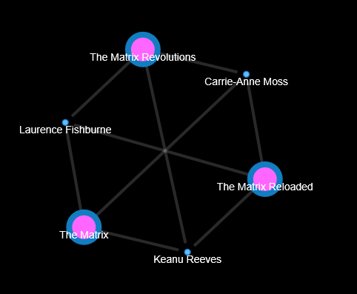
Visualize graph with Alchemy.js
First export graph to GraphJson
g.ExportToGraphJson("c:/QuickStart.json");
and then include in html doc

Slide 17
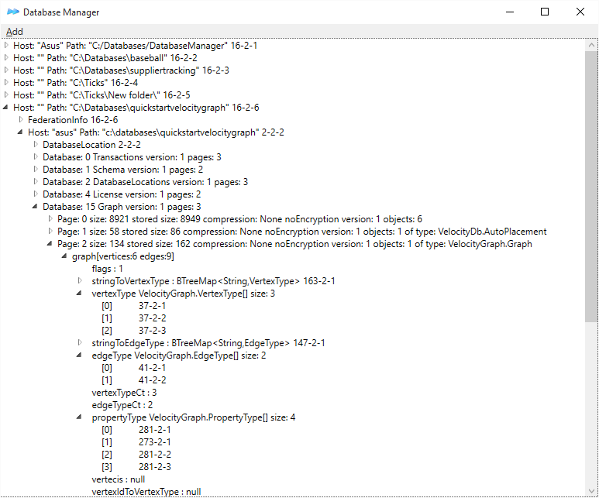
Browse graph with Database Manager
Notes:
Show DatabaseManager live with VelocityGraphQuickStart data

Slide 18
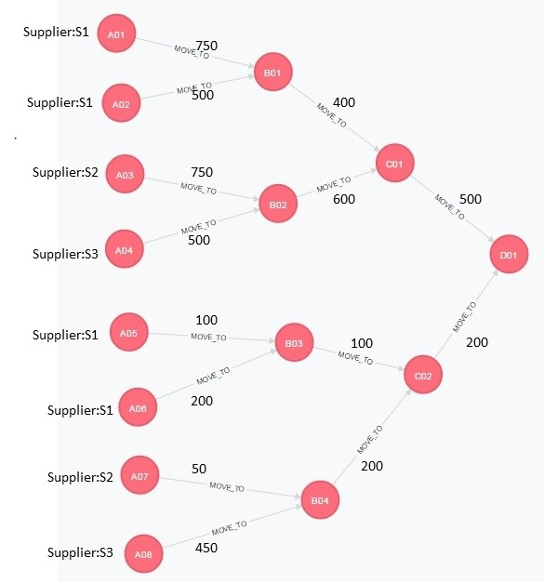
SupplierTracking
To summarize we start of with a bunch of leaf stores which all are associated with a particular supplier, which is a property on the Store node. Inventory is then moved along to other stores and the proportion from each supplier corresponds to their contribution to the original store.
So for node B02, S2 contributed 750/1250 = 60% and S3 contributed 40%. We then move 600 units our of B02 of which 60% belongs to S2 and 40% to S3 and so on.
What we want to know what percentage of the final 700 units into D01 belong to each supplier. Where suppliers with the same name are the same supplier.
Notes:
Show StackOverflow web site and describe problem.

Slide 19
Simple to do with C# and VelocityGraph!
Console.WriteLine("Supplier 1 to Warehouse D total: " + supplierTracking.CalculateTotalTo(supplier1, supplierWarehouseEdgeType, moveToS1EdgeType, howManyS1Property, wareHouseD1));
Console.WriteLine("Supplier 2 to Warehouse D total: " + supplierTracking.CalculateTotalTo(supplier2, supplierWarehouseEdgeType, moveToS2EdgeType, howManyS2Property, wareHouseD1));
Console.WriteLine("Supplier 3 to Warehouse D total: " + supplierTracking.CalculateTotalTo(supplier3, supplierWarehouseEdgeType, moveToS3EdgeType, howManyS3Property, wareHouseD1));
int CalculateTotalTo(Vertex supplier, EdgeType supplierWarehouseEdgeType, EdgeType moveToEdgeType, PropertyType howManyProperty,
Vertex toVertex)
{
int total = 0;
HashSet<Vertex> excludeSet = new HashSet<Vertex>();
foreach (IEdge wareHouseEdge in supplier.GetEdges(supplierWarehouseEdgeType, Direction.Out))
{
Vertex supplierWareHouse = (Vertex)wareHouseEdge.GetVertex(Direction.In);
var allPaths = supplierWareHouse.Traverse(toVertex, moveToEdgeType, 10, true, null, excludeSet);
foreach (List<Edge> path in allPaths)
{
if (path.Count > 0)
total += (int)path.Last().GetProperty(howManyProperty); // last because that is all we care about in this simplified sample
foreach (Edge edge in path)
{
excludeSet.Add(edge.Tail);
}
}
}
return total;
}

Slide 20
Same problem using Neo4J
MATCH p =s<-[:MOVE_TO*]-sup WHERE HAS (sup.Supplier) AND NOT HAS (s.Supplier) WITH s,sup,reduce(totalSupplier = 0, r IN relationships(p)| totalSupplier + r.Quantity) AS TotalAmountMoved WITH sum(TotalAmountMoved) AS sumMoved, collect(DISTINCT ([sup.Supplier, TotalAmountMoved])) AS MyDataPart1,s WITH reduce(b=[], c IN MyDataPart1| b +[{ Supplier: c[0], Quantity: c[1], Percentile: ((c[1]*1.00))/(sumMoved*1.00)*100.00 }]) AS MyData, s, sumMoved RETURN s.Name, sumMoved, MyData
???

Slide 21
Dating Recommendations
Dating site with ratings. Can be used to recommend other people a user might like.
17 million ratings, 168 000 profiles that are rated by 135 000 users.
All ratings are contained in the file "ratings.dat" and are in the following format:
UserID,ProfileID,Rating
- UserID is user who provided rating
- ProfileID is user who has been rated
- UserIDs range between 1 and 135,359
- ProfileIDs range between 1 and 220,970 (not every profile has been rated)
- Ratings are on a 1-10 scale where 10 is best (integer ratings only)
- Only users who provided at least 20 ratings were included
- Users who provided constant ratings were excluded
User gender information is in the file "gender.dat" and is in the following format:
UserID,Gender
- Gender is denoted by a "M" for male and "F" for female and "U" for unknown

Slide 22
Graph structure selected
User Vertices
Id: 1
Gender: M
Id: 2
Gender: F
Id: 3
Gender: M
Id: 4
Gender: U
Id: 5
Gender: M
Id: 168,791
Gender: M
Rating Of Edge
For each rating, add 2 edges. One relating user with a rating and another one relating rated by with rated user.
User to Rating Edge
Rating Vertices
Id: 1
Rating: 1
Id: 2
Rating: 2
Id: 3
Rating: 3
Id: 4
Rating: 4
Id: 5
Rating: 5
Id: 6
Rating: 6
Id: 7
Rating: 7
Id: 8
Rating: 8
Id: 9
Rating: 9
Id: 10
Rating: 10
Notes:
One way to represent this in a graph is like this.
Create 168,000 user vertices and 10 rating vertices (one for each possible rating)
For each rating create an edge from rater user to rated user and another edge from rated user to its rating. Do so for all 17 million ratings.

Slide 23
Queries
Complex queries
- Given a user id, and based on the rated profiles, find other users who have rated similarly on the same profiles, and find other profiles to recommend based on what those other users have rated
- Get all female users with less than 50 ratings
- Get all male users with at least one 10 rating
- Get the first 10 male users who have rated at least 3 of the same profiles as the given user.
Statistics queries
- Get the 20 profiles with the most ratings
- Get the 20 best rated profiles regardless of gender
- Get the 20 best rated males
- Get the 20 best rated females
Notes:
Given this data and our graph we want to be able to do the following queries.

Slide 24
Get the 20 best rated profiles regardless of gender
var ratingsVertexEnum = from v in ratingType.GetVertices() orderby v.GetProperty(ratingValuePropertyType) descending select v;
Vertex rating10Vertex = ratingsVertexEnum.First();
// Get the 20 best rated profiles regardless of gender
var top = from u in userType.GetVertices()
let edgeCt = u.GetNumberOfEdges(ratingEdgeType, rating10Vertex, Direction.Out)
orderby edgeCt descending
select new { u, edgeCt };
Console.WriteLine("20 best rated profiles regardless of gender");
ct = 0;
foreach (var v in top)
{
if (++ct > 20)
break;
Console.WriteLine("User id: " + v.u.VertexId + “\t10 ratings: " + v.edgeCt);
}
Notes:
Let’s pick one of them

Slide 25
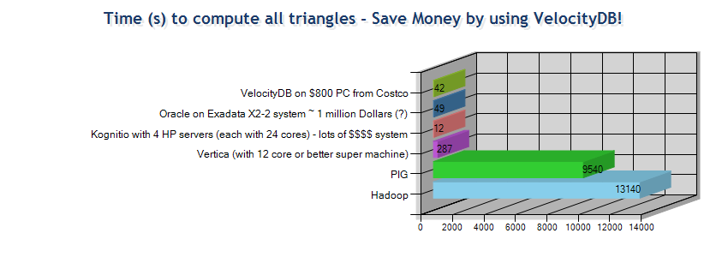
Triangle Counter
This test idea started with a Vertica comparison with Hadoop and PIG. Given 86,220,856 tuples compute the number of triangles that can be formed from these edges.
[c:\]more edges.txt
208761 293938
208761 293946
208761 299583
208761 316917
208761 377488
208761 377492
Number of Nodes found: 4,846,609
Number of Triangles found: 285,730,264
Notes:
Show Vertica web page.

Slide 26
Kevin Bacon Distance
Computes the degree of separation between Kevin Bacon and all other actors and actresses (~ 2 million) taking part in about 350,000 movies.
0 degrees means you are Kevin Bacon
1 degree, you acted in one of Kevin Bacon's movies
2 degrees, you acted in a movie with someone who acted in the same movie as Kevin Bacon
and so on...
The output looks similar to Oracle of Bacon (which by the way is not using an Oracle database!)
[c:\VelocityDb\Release]timer& KevinBaconNumbers.exe& timer
Timer 1 on: 12:07:04
Degree 0 has # of people: 1
Degree 1 has # of people: 3475
Degree 2 has # of people: 385345
Degree 3 has # of people: 894996
Degree 4 has # of people: 121903
Degree 5 has # of people: 7462
Degree 6 has # of people: 446
Degree 7 has # of people: 28
Degree 8 has # of people: 0
Degree 9 has # of people: 0
Timer 1 off: 12:07:33 Elapsed: 0:00:29.81
Notes:
Describe and Show Oracle of Bacon web page

